Slide 1
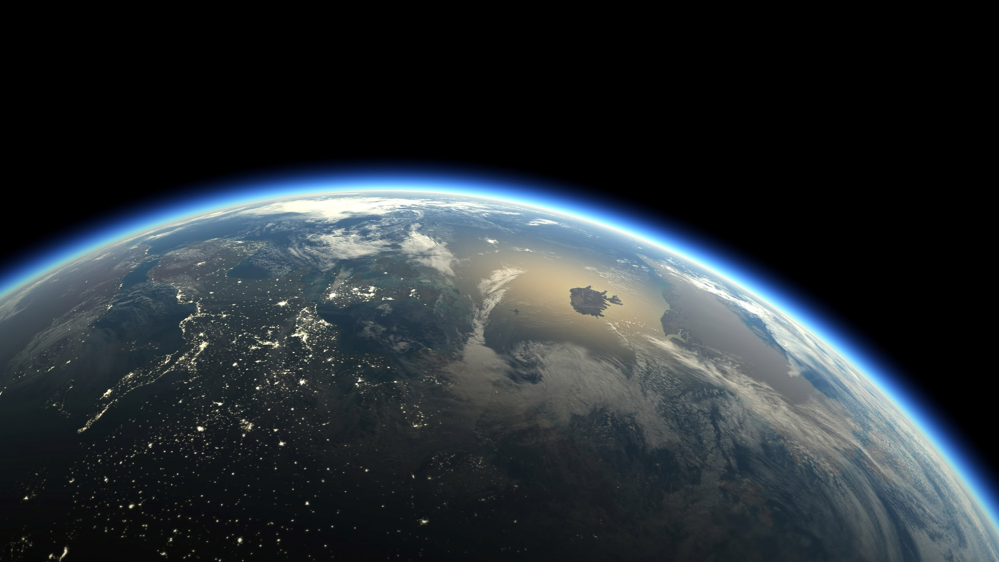

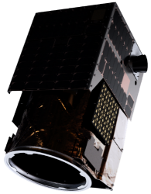
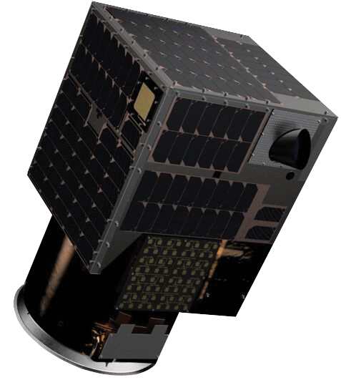
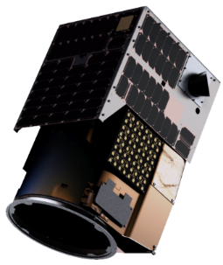

SATELLITES & AI TRANSFORMING INSURANCE MARKETS
Mendoza 2020

Slide 2
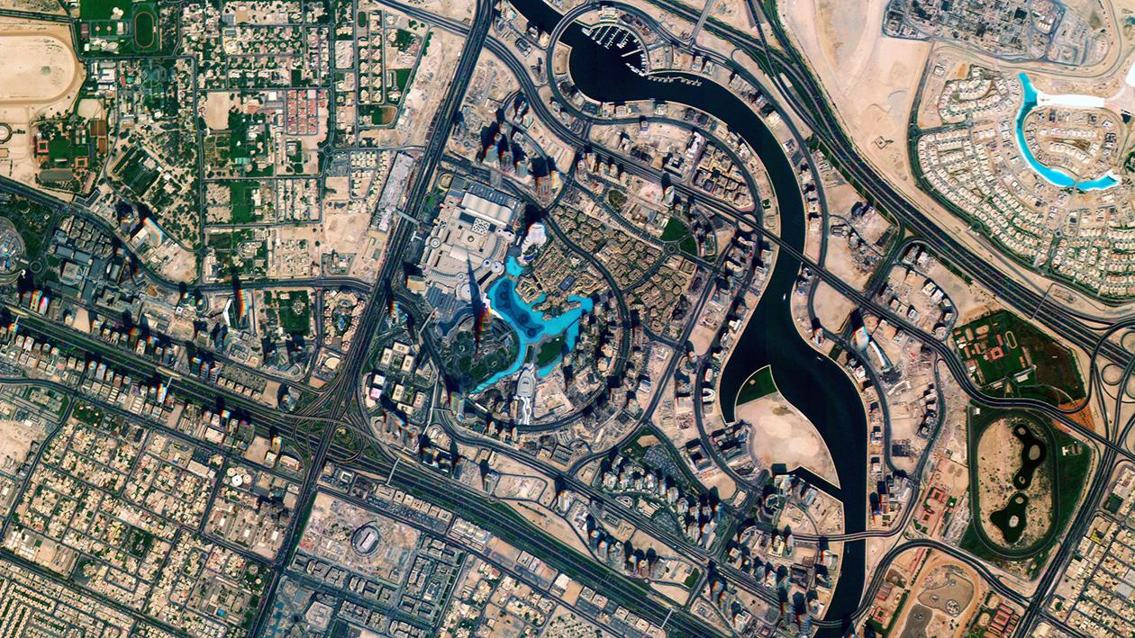
Our Edge
Our Imagery
Louisiana, USA, 2019
Hyperspectral image
Dubai, UAE (BURJ KHALIFA)
Multispectral image

Slide 3
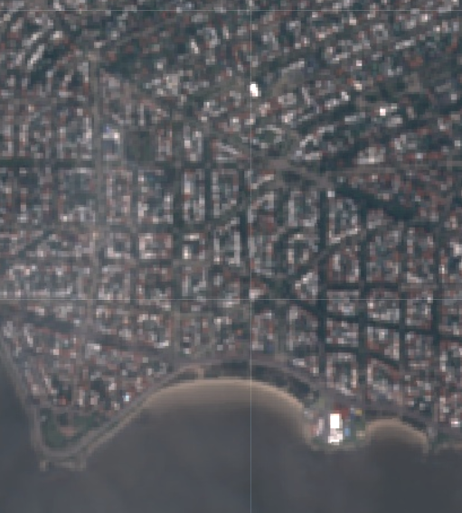
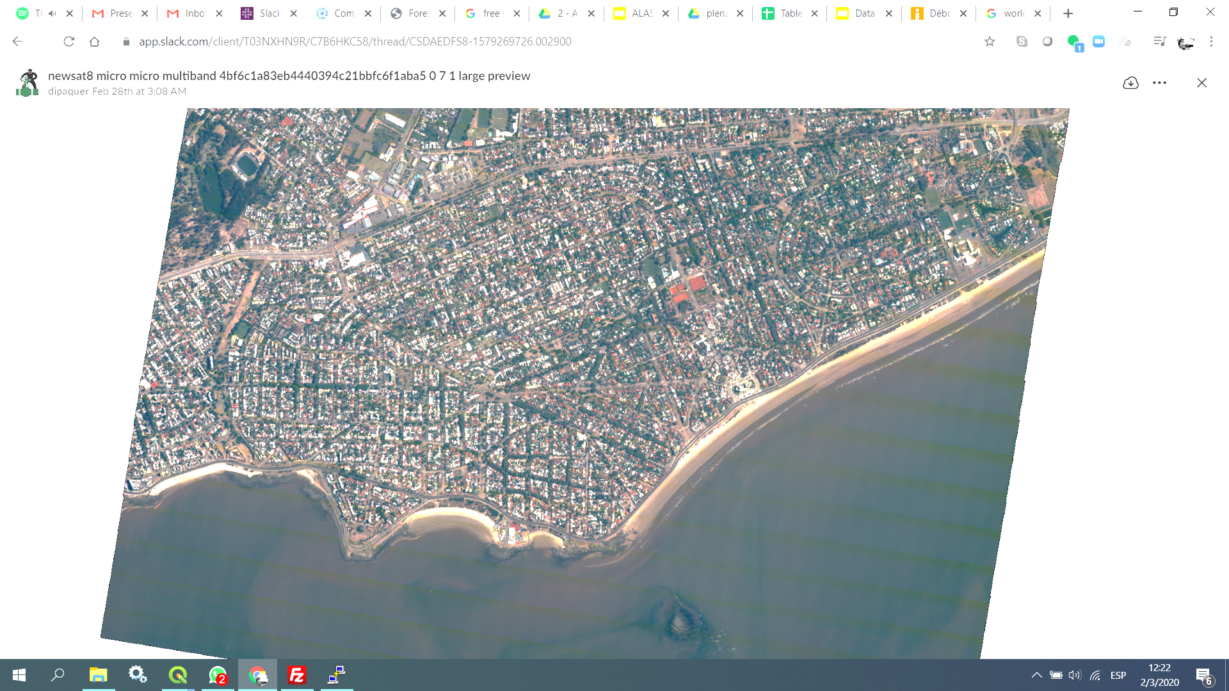
High resolution
Low resolution to high resolution. Now you see!
1mt GSD Multispectral imagery
Montevideo, UY
Multispectral image

Slide 4
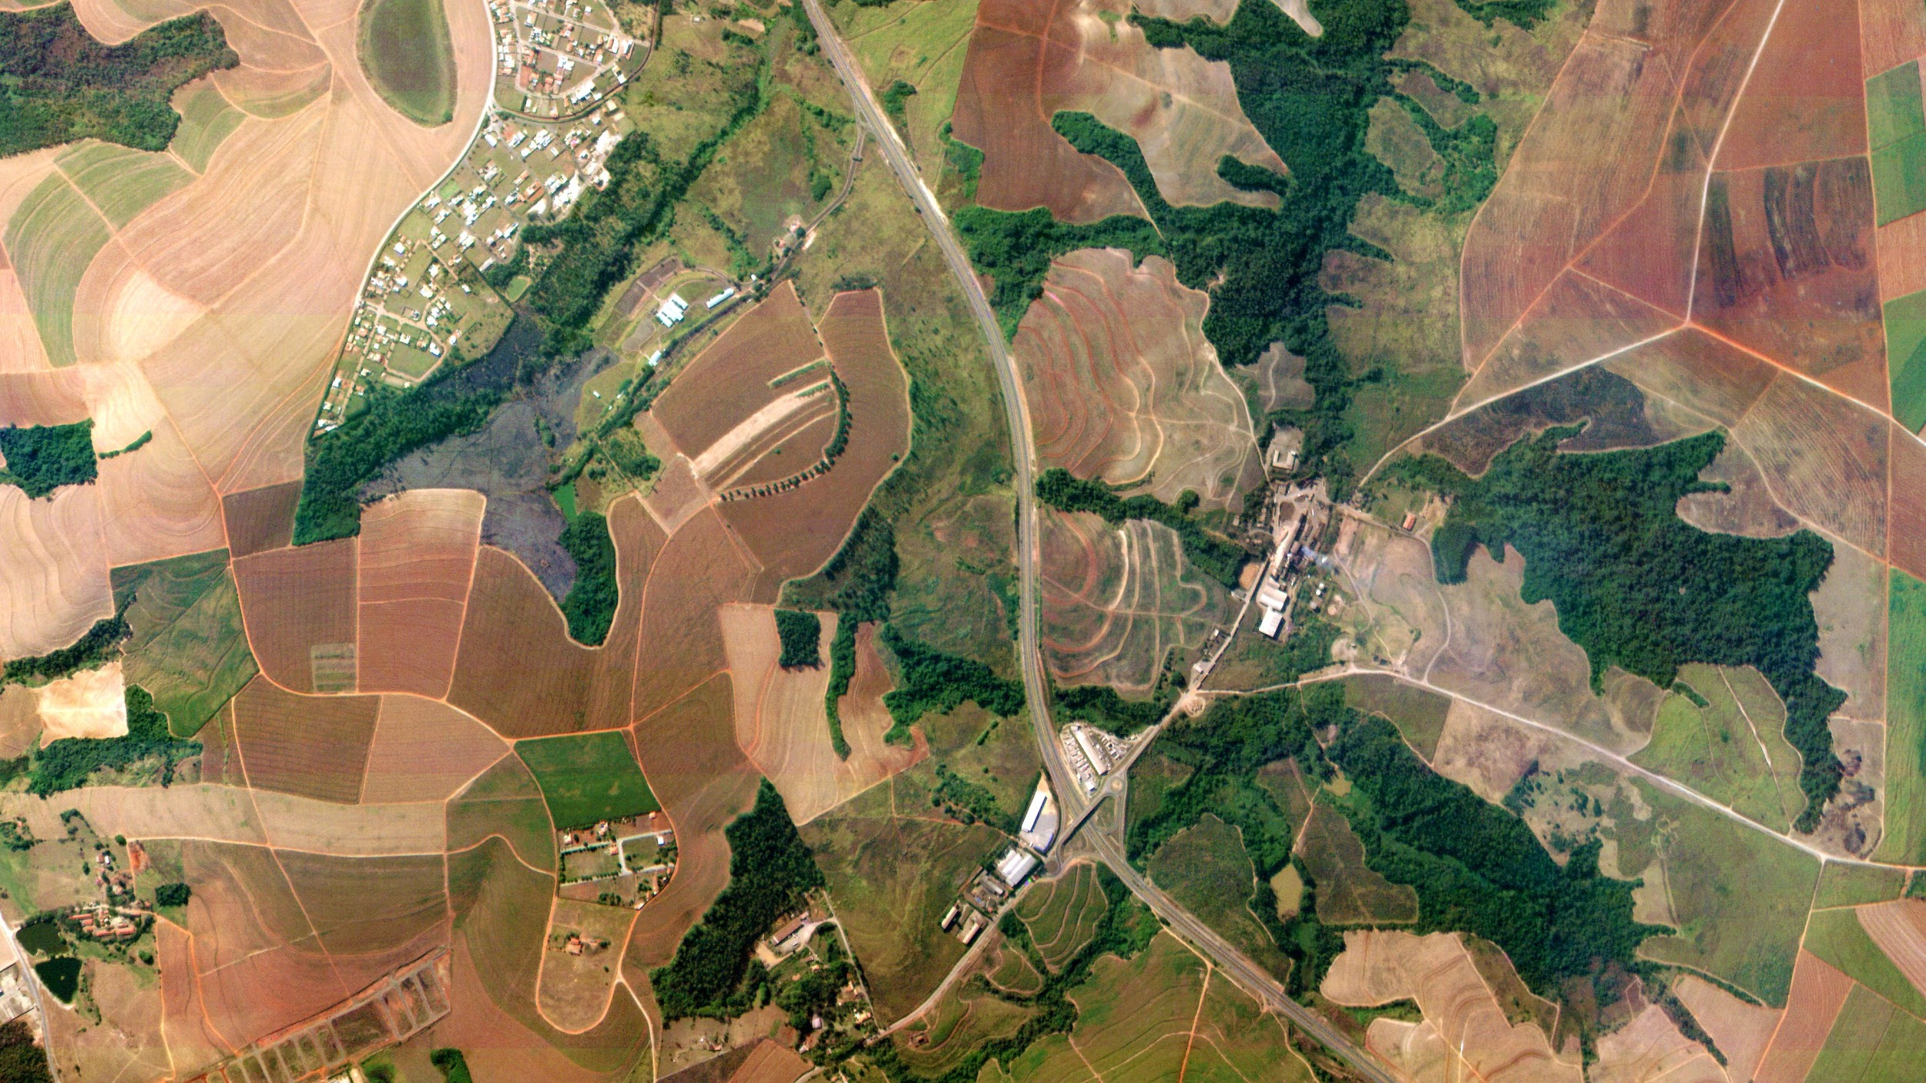
High frequency
Our Imagery
Louisiana, USA, 2019
Hyperspectral image
Piracicaba, Brazil
Multispectral image

Slide 5
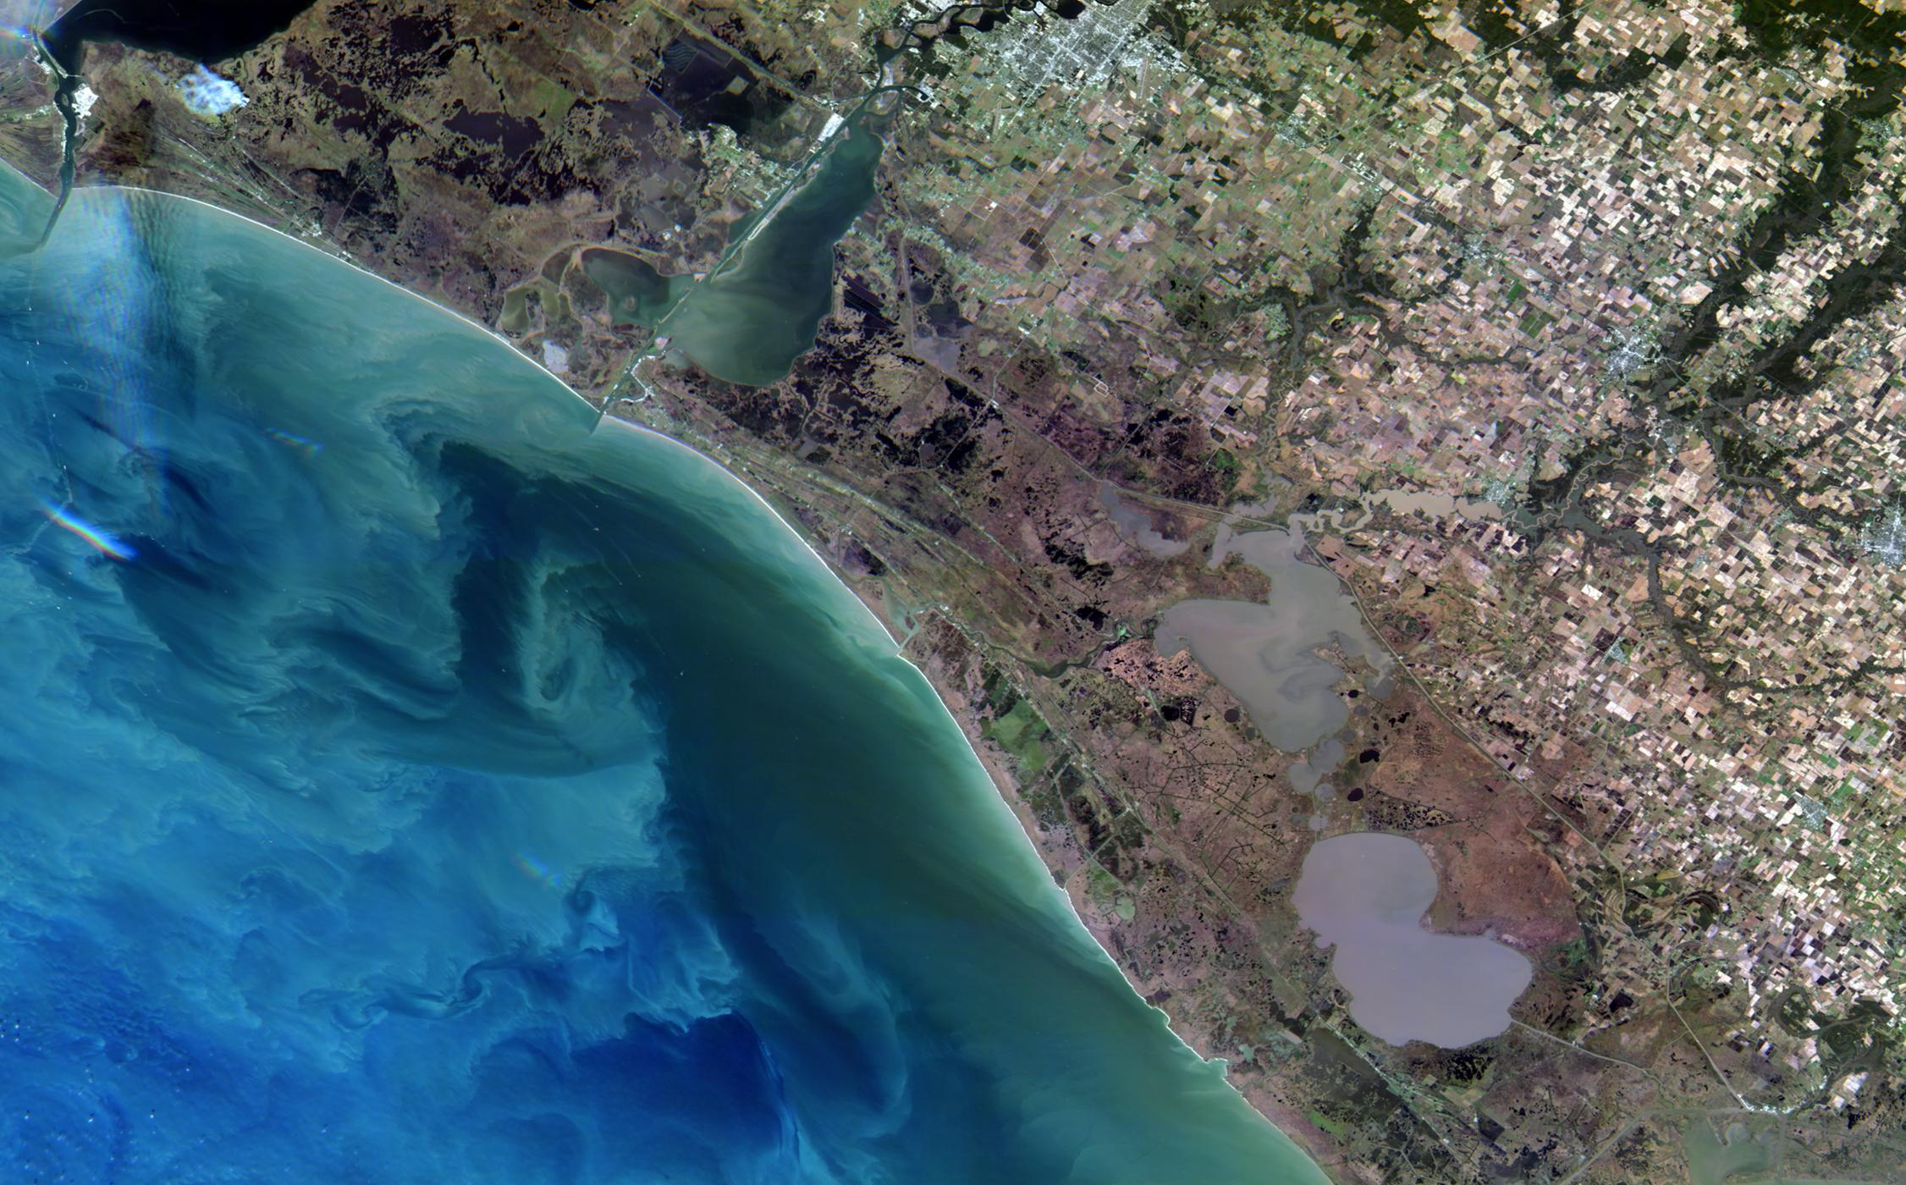
Hyperspectral
Our Imagery
Louisiana, USA
Hyperspectral image
30mt GSD hyperspectral imagery

Slide 6
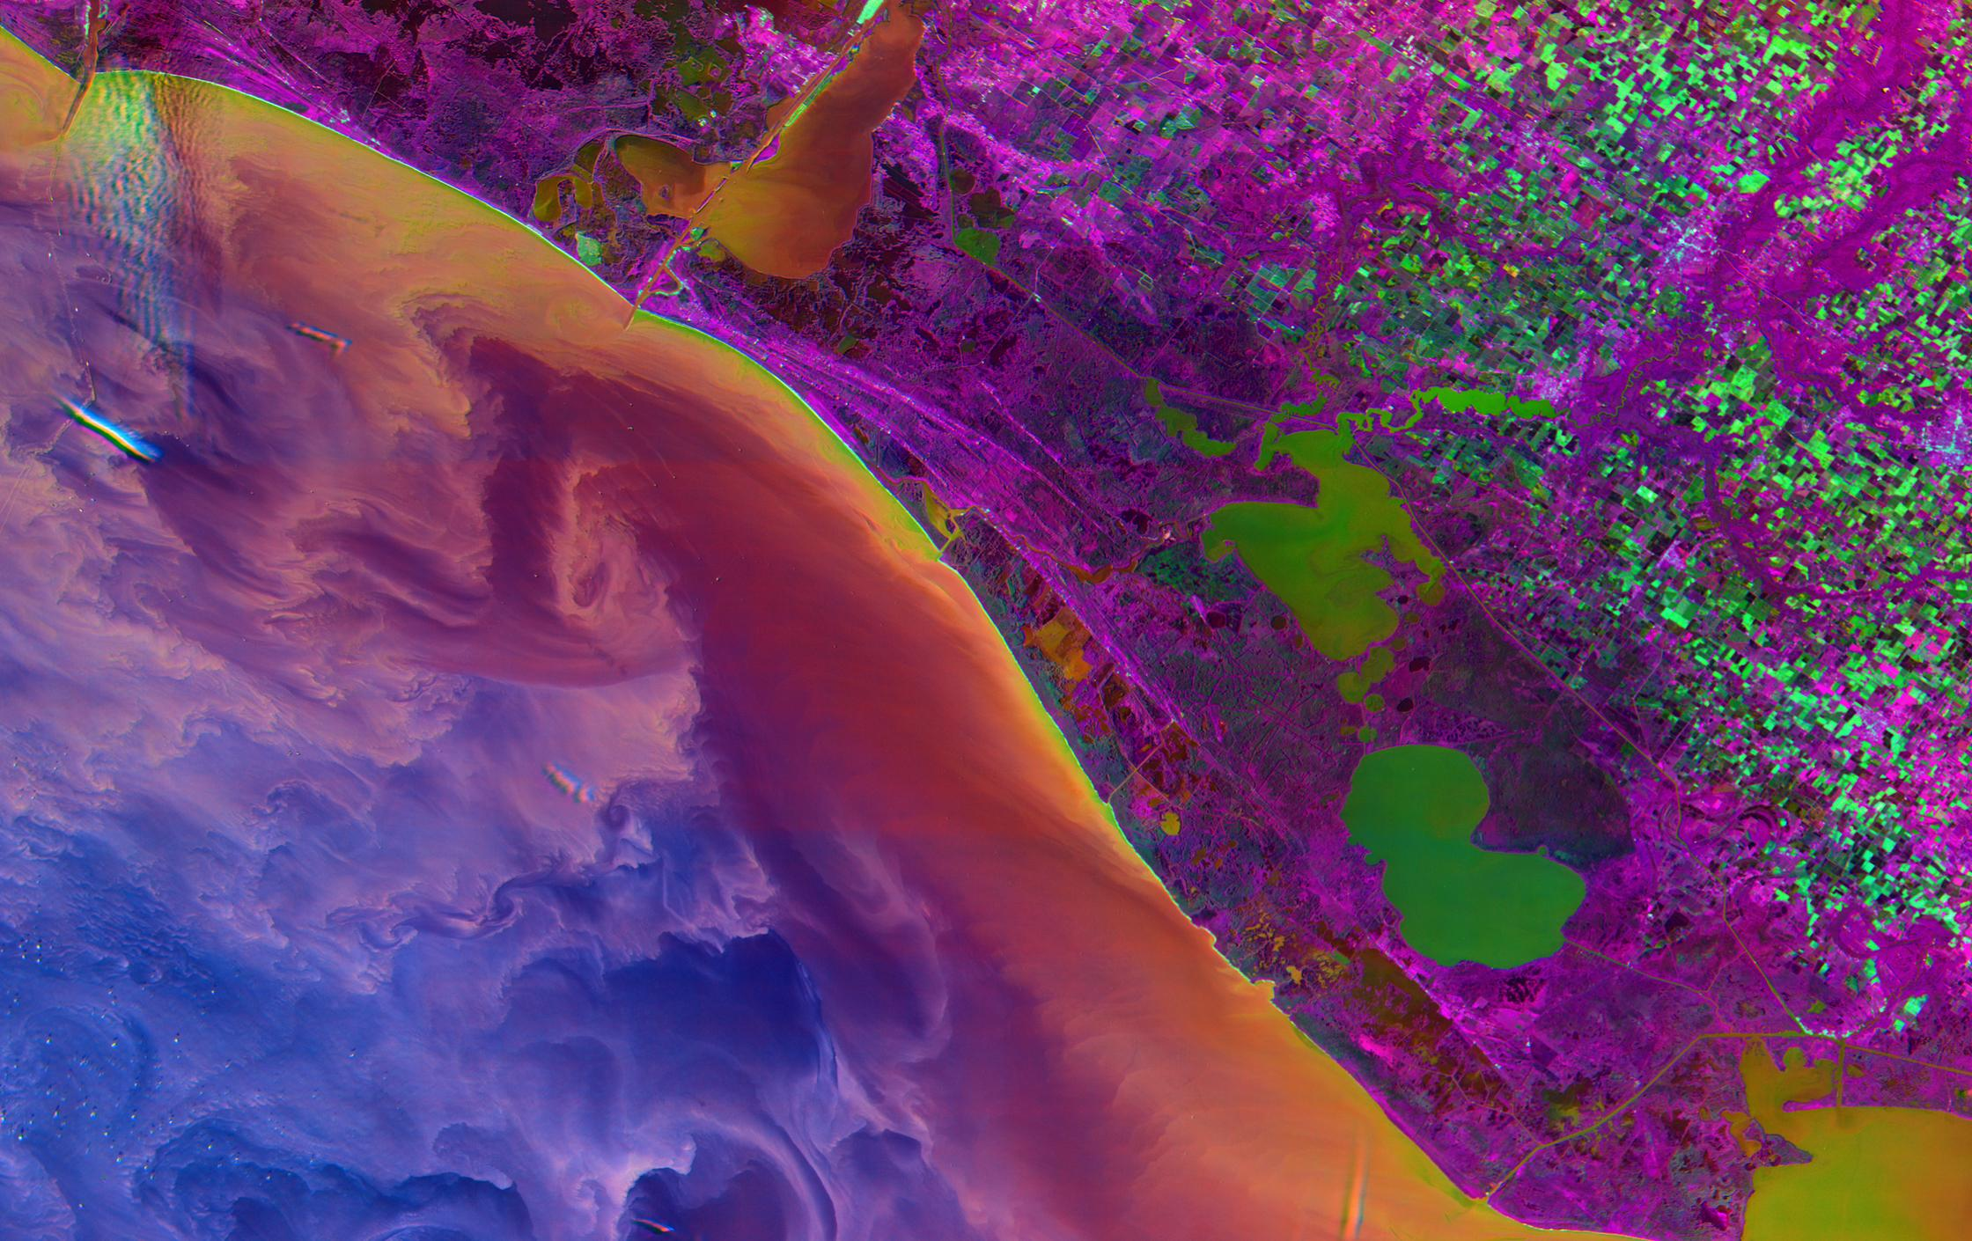
Superpowers
Our Edge
Our Imagery
Louisiana, USA, 2019
Hyperspectral image
Louisiana, USA
Hyperspectral image

Slide 7
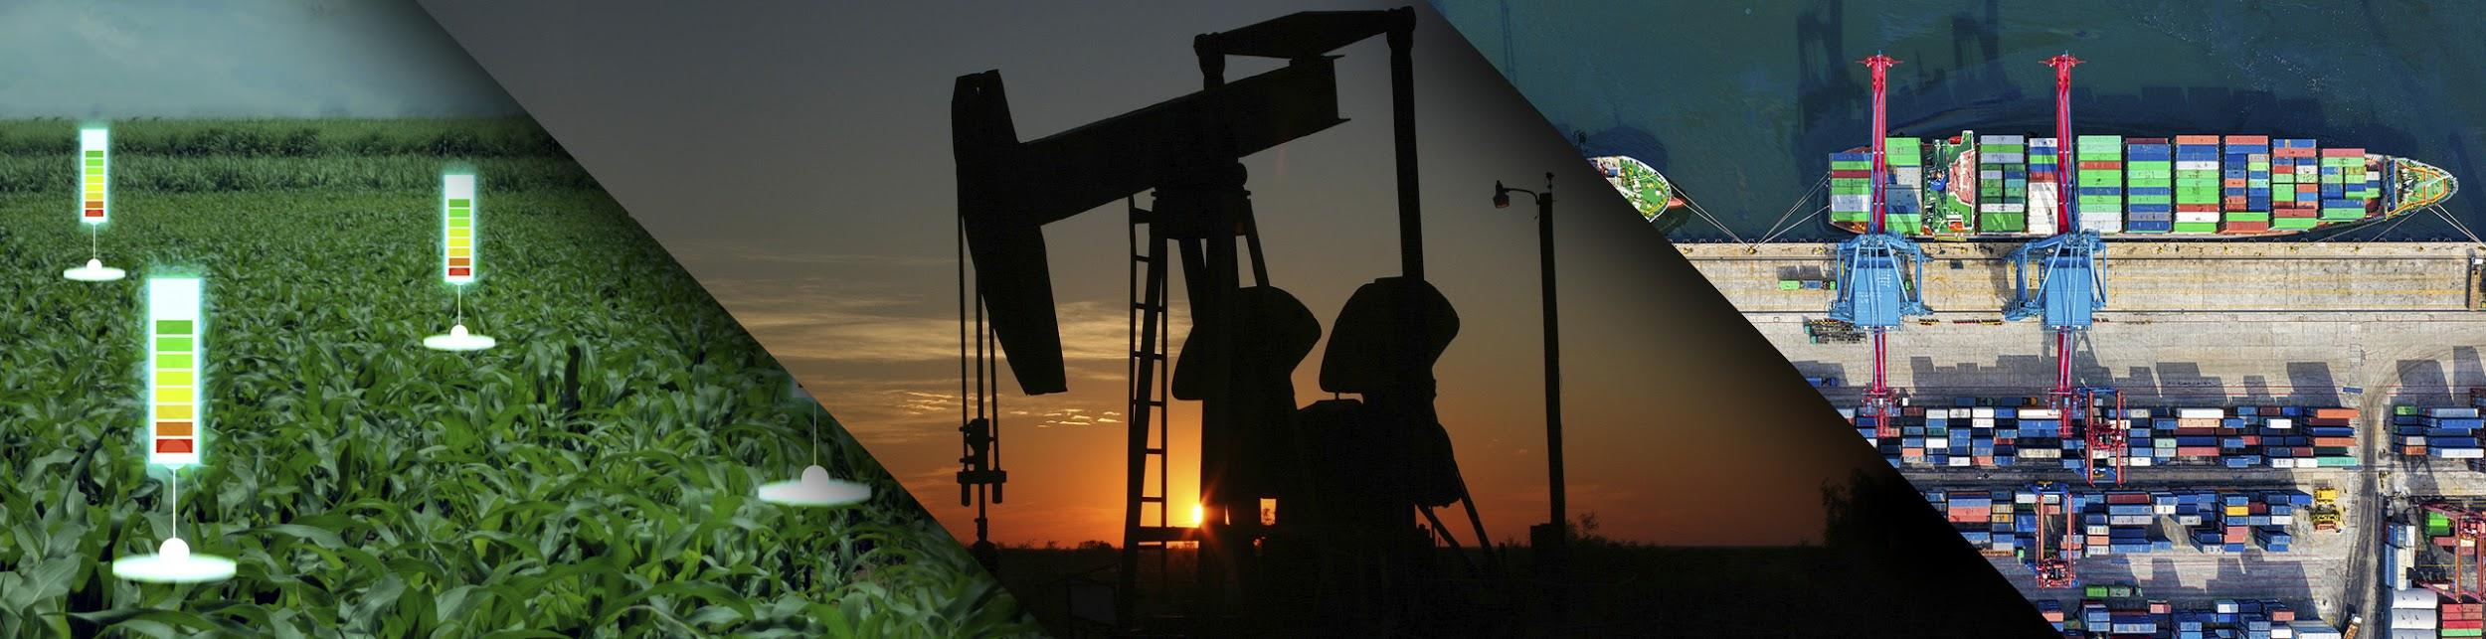

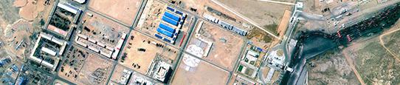



WHY DOES 1mt MATTER?
Most application require 1-meter weekly remaps
Urban monitoring
Forestry Inventory
Soil monitoring
Cartography
Pest Detection
Fire Detection
1m
Tree Counting
Irrigation Monitoring
Infrastructure Planning
Crop Health Monitoring
Infrastructure monitoring
Pipeline Monitoring
Tillage Monitoring
1-meter
RESOLUTION
Exploration
5m
Crop Type Estimation
5-meters
Yield Prediction
10m
Land Use
Vegetative Indices
10-meters
Monthly
Weekly
Daily
1-meter resolution is the sweet spot to monitor/detect the economic activity of the planet.
DATA FREQUENCY
Agriculture
Energy
Forestry
Infrastructure

Slide 8
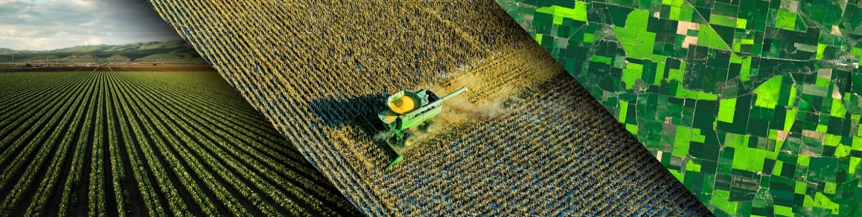
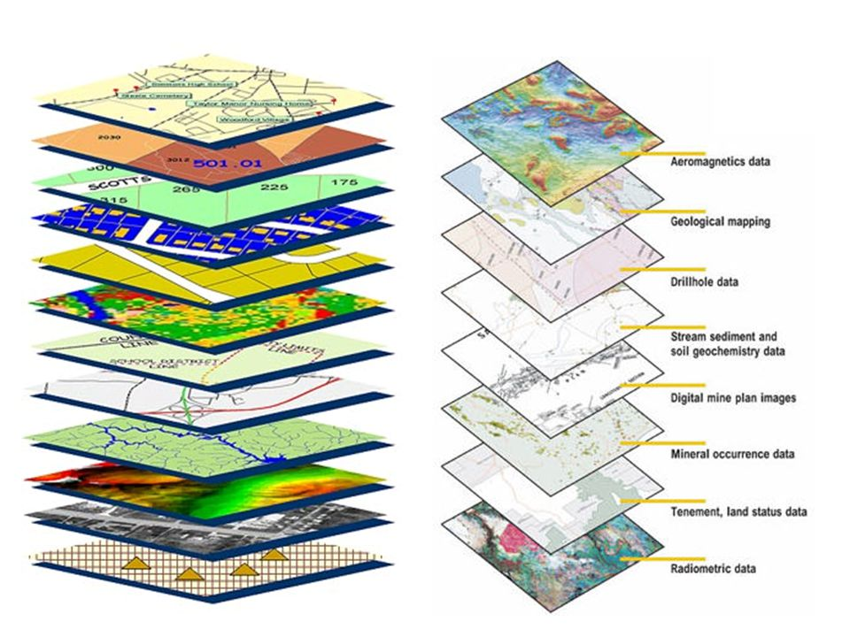


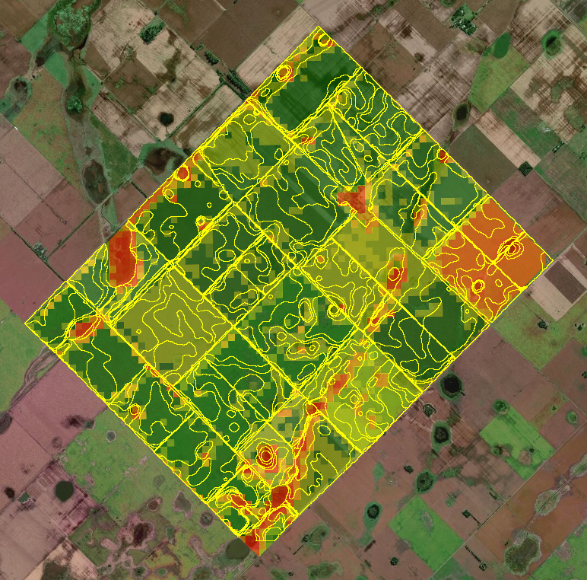
INSURANCE SOLUTIONS
SATELLOGIC: THE PROCESS
=
Satellite Images
AI & Machine Learning Models
SOIL Information
Multiple & Scalable
Data Sources
Crop Data
Weather information
Other data
sources
Geospatial data can be seen as stacked layers over a given location
BUSINESS TRANSFORMATION:
Unique Insights for daily decision making

Slide 9


GRACIAS!

